Slide 1
Job Order Costing
Masud Jahan
Department of Science and Humanities Military Institute of Science and Technology

Slide 2
Managerial Accounting Lecture 06: Job Order Costing
Chapter 20
Masud Jahan
Department of Science and Humanities Military Institute of Science and Technology

Slide 3
study objectives
Explain the characteristics and purposes of cost accounting.
Describe the flow of costs in a job order costing system.
Explain the nature and importance of a job cost sheet.

Slide 4

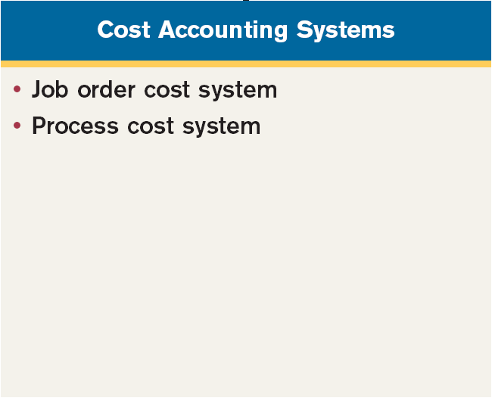
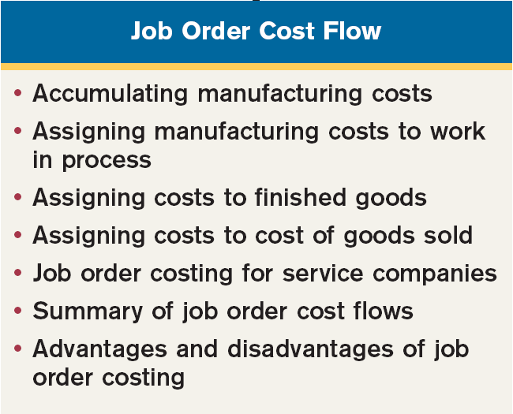
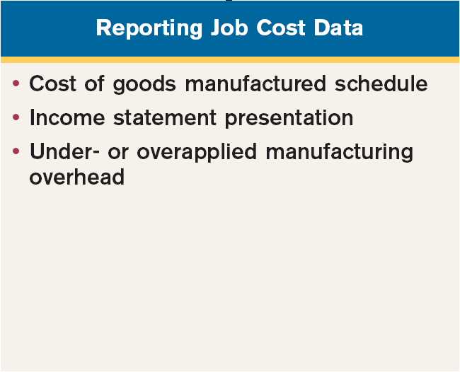
Preview

Slide 5
Cost Accounting Systems
Cost Accounting involves:
Measuring,
Recording, and
Reporting of product costs
Accounts are fully integrated into the general ledger.
Perpetual inventory system provides immediate, up-to-date information.
Two basic types: (1) a job order cost system and (2) a process cost system.
SO 1 Explain the characteristics and purposes of cost accounting.

Slide 6
Cost Accounting Systems
Job Order Cost System
Costs are assigned to each job or batch.
A job may be for a specific order or inventory.
A key feature: Each job or batch has its own distinguishing characteristics.
The objective: To compute the cost per job.
Measures costs for each job completed – not for set time periods.
SO 1 Explain the characteristics and purposes of cost accounting.

Slide 7
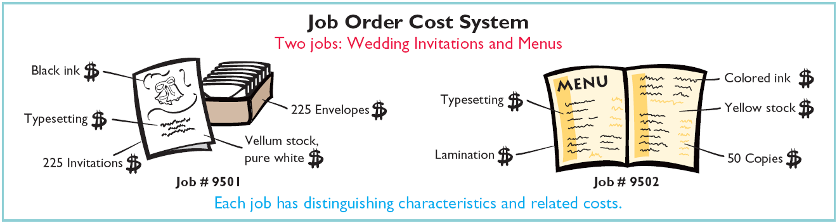
Cost Accounting Systems
Illustration 2-1
SO 1 Explain the characteristics and purposes of cost accounting.

Slide 8
Cost Accounting Systems
Process Cost System
Used when a large volume of similar products are manufactured - (Cereal, Automobiles, Compact Discs, Paint).
Costs are accumulated for a specific time period – (week or month).
Costs are assigned to departments or processes for a set period of time.
SO 1 Explain the characteristics and purposes of cost accounting.

Slide 9
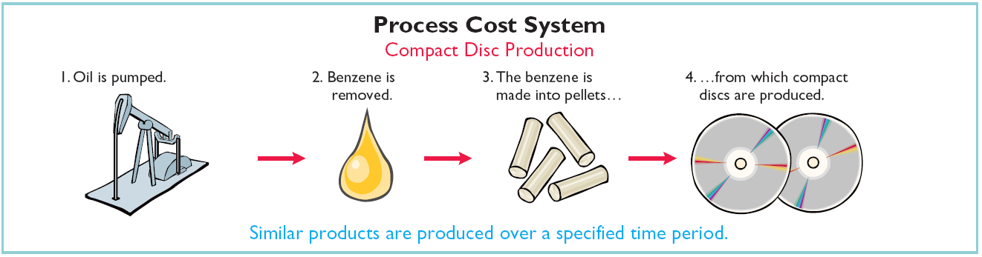
Cost Accounting Systems
Illustration 2-2
SO 1 Explain the characteristics and purposes of cost accounting.

Slide 10
Cost Accounting Systems
Review Question
Cost accounting involves the measuring, recording, and reporting of:
a. Product costs.
b. Future costs.
c. Manufacturing processes.
d. Managerial accounting decisions.
a. Product costs.
b. Future costs.
c. Manufacturing processes.
d. Managerial accounting decisions.
SO 1 Explain the characteristics and purposes of cost accounting.

Slide 11
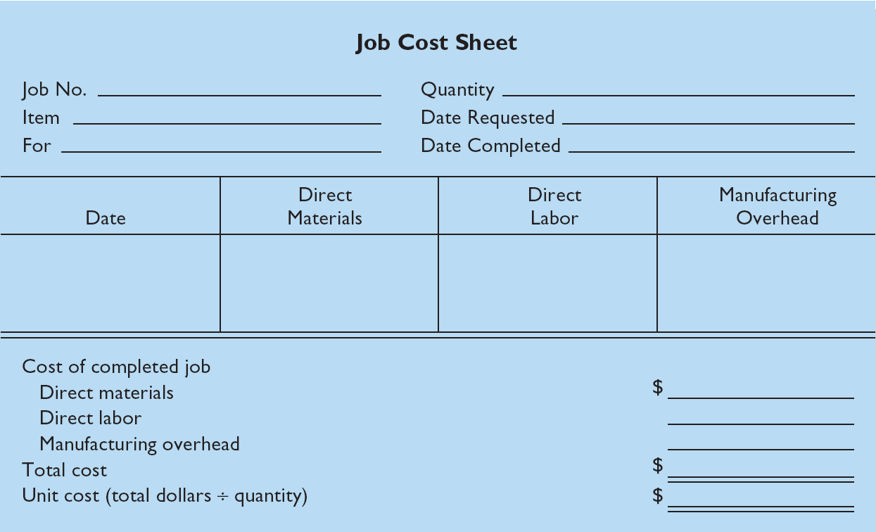
Job Order Cost Flow
Job Cost Sheet
Illustration 2-5
SO 3 Explain the nature and importance of a job cost sheet.

Slide 12
End of Lecture 06 THANK YOU ALL…

